Slide 1

Administrators’ Discussion/Q & A
Presented by Hunter R. Boylan, Ph.D., Professor and Director, NCDE

Slide 2
Developmental Education is…
“The integration of courses and support services guided by the principles of adult learning and development”

Slide 3
Some advice…
Make sure the exit standards for developmental courses are consistent with the entry standards of college level courses.
Share data with faculty and let them analyze and act on it.
Train adjunct faculty.
Get everyone involved in student success.

Slide 4
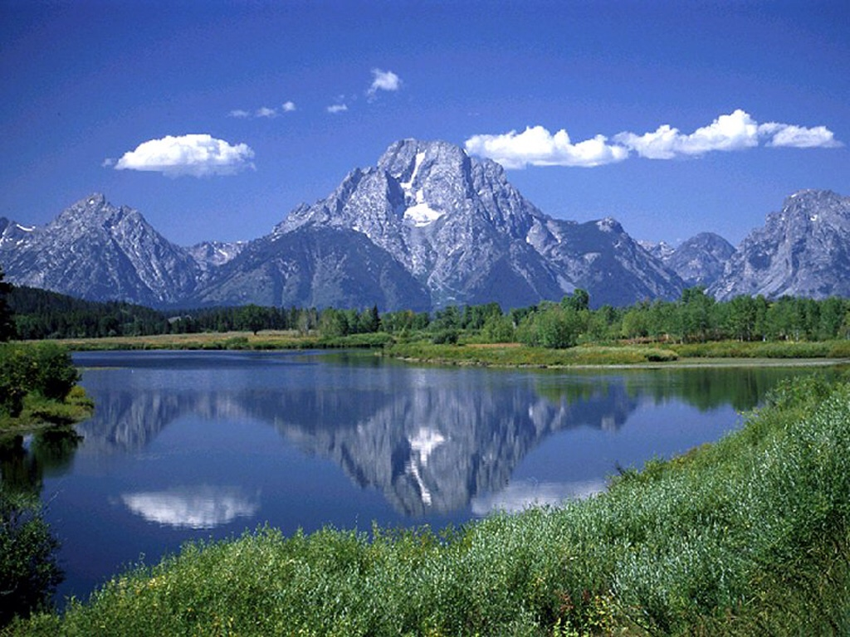
Have a Good Afternoon!

